Slide 1


Slide 2
INTRODUCTION
The Indian Premier League (IPL) is a professional Twenty20 cricket league in India, widely regarded as one of the most popular and lucrative T20 leagues globally. Launched in 2008 by the Board of Control for Cricket in India (BCCI), the IPL features franchise teams representing different cities. Known for its high-octane cricket, star-studded line-ups, and innovative formats, the IPL has become a cricketing extravaganza, attracting top international players.
With its blend of entertainment and competitive cricket, the IPL has not only revolutionized the sport but has also gained a massive fan base, making it a premier event in the cricketing calendar.

Slide 3


Slide 4
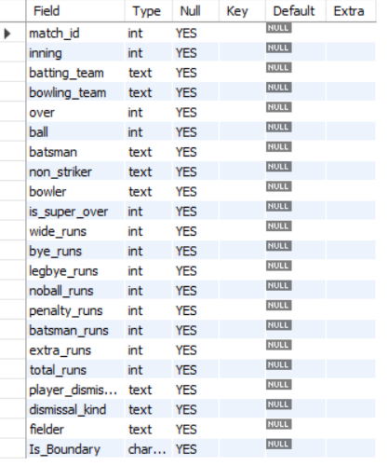

DATASET OVERVIEW
Table: Deliveries
DESC DELIVERIES;

Slide 5
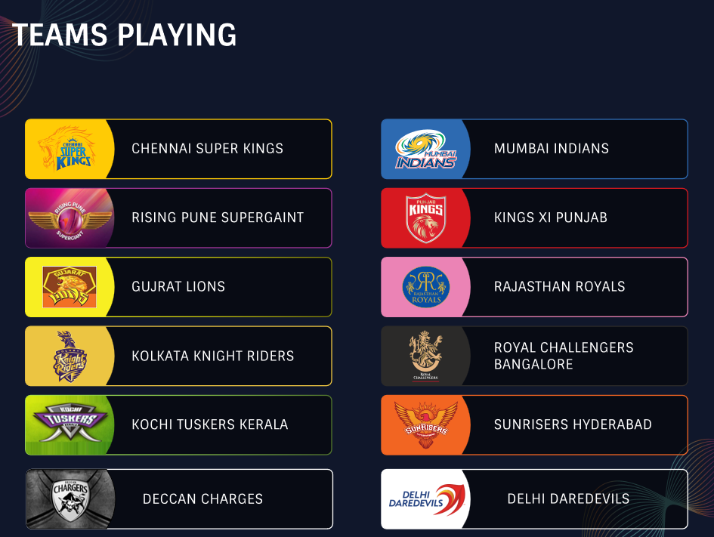

Slide 6


Key Analysis & Queries

Slide 7


The Total number of deliveries in the dataset.
1
Query:
SELECT COUNT(*) as Count_of_Total_Deliveries
FROM DELIVERIES;
There are a total of 1,50,460 deliveries listed in the deliveries table.
Output:

Slide 8
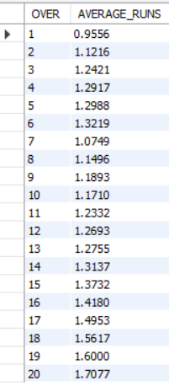
The average number of runs scored per over.
2
Query:
Output:
SELECT DELIVERIES.OVER,
AVG(TOTAL_RUNS) AS AVERAGE_RUNS
FROM DELIVERIES
GROUP BY DELIVERIES.OVER;

Slide 9

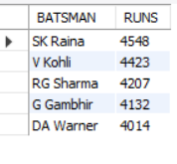
The Top 5 batsmen with the highest total runs scored.
3
Query:
SELECT BATSMAN,
SUM(BATSMAN_RUNS) AS RUNS
FROM DELIVERIES
GROUP BY BATSMAN
ORDER BY RUNS DESC
LIMIT 5;
Output:

Slide 10

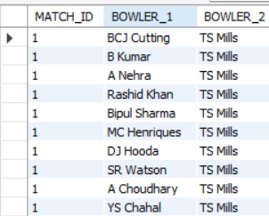
All pairs of bowlers who bowled in the same match.
4
Query
SELECT DISTINCT(D1.MATCH_ID),
D1.BOWLER AS BOWLER_1,
D2.BOWLER AS BOWLER_2
FROM DELIVERIES AS D1
JOIN DELIVERIES AS D2
ON D1.MATCH_ID=D2.MATCH_ID
AND D1.BOWLER<>D2.BOWLER;
Output:

Slide 11

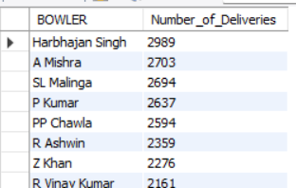
The total number of deliveries bowled by each bowler.
5
Query:
SELECT BOWLER,
COUNT(BALL) AS Number_of_Deliveries
FROM DELIVERIES
GROUP BY BOWLER
ORDER BY Number_of_Deliveries DESC;
Output:

Slide 12

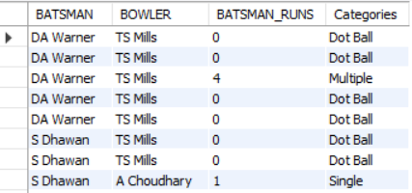
Using a CASE statement to categorize deliveries into three categories based on runs scored: Dot Ball for 0 runs, Single for 1 run, and Multiple for more than 1 run.
6
Query:
SELECT BATSMAN, BOWLER, BATSMAN_RUNS,
CASE
WHEN BATSMAN_RUNS=0 THEN "Dot Ball"
WHEN BATSMAN_RUNS=1 THEN "Single"
WHEN BATSMAN_RUNS>1 THEN "Multiple"
END AS Categories
FROM DELIVERIES;
Output:

Slide 13
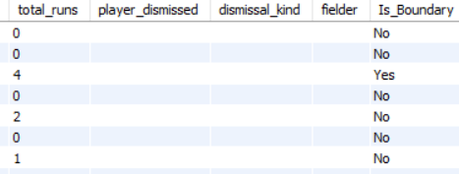
To add a new column is_boundary to the deliveries table that indicates if the delivery resulted in a boundary (4 or 6 runs).
7
Query:
ALTER TABLE DELIVERIES ADD COLUMN(Is_Boundary char(3));
UPDATE DELIVERIES SET Is_Boundary="No" where BATSMAN_RUNS<>4 OR BATSMAN_RUNS<>6;
UPDATE DELIVERIES SET Is_Boundary="Yes" where BATSMAN_RUNS=4 OR BATSMAN_RUNS=6;
SELECT * FROM DELIVERIES;
Output:

Slide 14
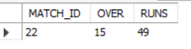
An advanced function to find the over with the highest total runs scored.
8
Query:
WITH CT1 AS
(
SELECT MATCH_ID,DELIVERIES.OVER,
SUM(TOTAL_RUNS) AS RUNS
FROM DELIVERIES
GROUP BY MATCH_ID,DELIVERIES.OVER
ORDER BY SUM(TOTAL_RUNS) DESC
LIMIT 1
)
SELECT * FROM CT1;
Output:

Slide 15
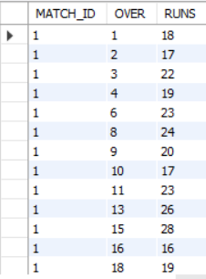
Create a view named HighScoringOvers that includes overs where the total runs scored are more than 15.
9
Query:
Output:
CREATE VIEW HighScoringOvers AS
(
SELECT MATCH_ID,DELIVERIES.OVER,
SUM(TOTAL_RUNS) AS RUNS
FROM DELIVERIES
GROUP BY MATCH_ID,DELIVERIES.OVER
HAVING SUM(TOTAL_RUNS)>15
);
SELECT * FROM HIGHSCORINGOVERS;

Slide 16

Using a window function to rank deliveries based on their total_runs within each match_id.
10
Query:
WITH CT1 AS (
SELECT MATCH_ID, DELIVERIES.OVER,
SUM(TOTAL_RUNS) AS Total_Runs
FROM DELIVERIES
GROUP BY MATCH_ID,DELIVERIES.OVER
)
SELECT dense_rank()
OVER(PARTITION BY MATCH_ID ORDER BY Total_Runs) AS RANKING ,
MATCH_ID, CT1.OVER, Total_runs AS Total_Runs
FROM CT1;

Slide 17
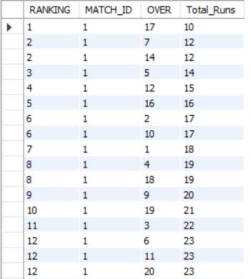

Output:

Slide 18
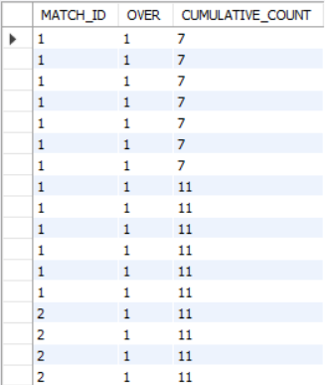
The cumulative count of runs scored in each match sorted by over.
11
Query:
Output:
SELECT MATCH_ID, DELIVERIES.OVER, SUM(TOTAL_RUNS)
OVER(partition by MATCH_ID,inning ORDER BY DELIVERIES.OVER) AS CUMULATIVE_COUNT
FROM DELIVERIES;

Slide 19
Stored procedure to update the runs scored on a delivery given its match_id, inning, over, ball, and new runs.
12
DELIMITER $$
CREATE PROCEDURE UpdateRunsOnDelivery(
IN p_match_id INT,
IN p_inning INT,
IN p_over INT,
IN p_ball INT,
IN p_new_runs INT
)
BEGIN
UPDATE DELIVERIES
SET TOTAL_RUNS = p_new_runs
WHERE MATCH_ID = p_match_id
AND INNING = p_inning
AND DELIVERIES.OVER = p_over
AND BALL = p_ball;
-- Optionally, you can return a message indicating success
SELECT 'Runs updated successfully' AS Message;
END$$
DELIMITER ;
Query:

Slide 20
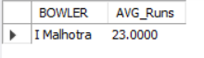
Find the bowler with the highest average runs conceded per over. Use subqueries and aggregate functions to achieve this.
13
Query:
SELECT BOWLER,AVG(RUNS) AS AVG_Runs
FROM (
SELECT MATCH_ID, BOWLER, DELIVERIES.OVER,
SUM(TOTAL_RUNS) AS RUNS
FROM DELIVERIES
GROUP BY MATCH_ID,BOWLER,DELIVERIES.OVER
) AS TMP GROUP BY BOWLER
ORDER BY Avg_RUNS DESC LIMIT 1;
Output:

Slide 21
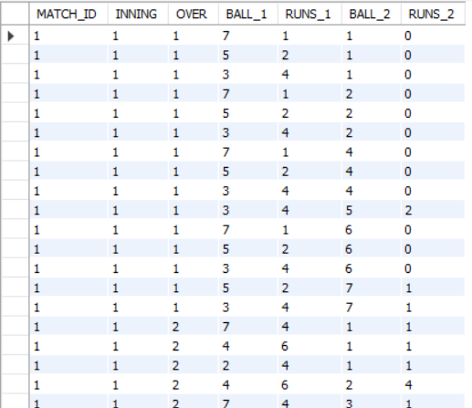
Find pairs of deliveries in the same over where one delivery resulted in more runs than the other.
14
Query:
Output:
SELECT B1.MATCH_ID,
B1.INNING,B1.OVER,
B1.BALL AS BALL_1,
B1.TOTAL_RUNS AS RUNS_1,
B2.BALL AS BALL_2,
B2.TOTAL_RUNS AS RUNS_2
FROM DELIVERIES AS B1
JOIN DELIVERIES AS B2
ON B1.MATCH_ID=B2.MATCH_ID
AND B1.INNING=B2.INNING
AND B1.OVER=B2.OVER
AND B1.TOTAL_RUNS > B2.TOTAL_RUNS
AND B1.BALL <>B2.BALL;

Slide 22
Additional Problems & Solution
Q1:To list all deliveries with their match_id, inning, over, and ball.
--SELECT match_id, inning, deliveries.over, ball
FROM deliveries;
Q2: Display all columns for deliveries bowled by a specific bowler, J Bumrah.
--SELECT * FROM DELIVERIES
WHERE BOWLER="JJ Bumrah";
Q3: List deliveries where the batting_team is Mumbai Indians.
--SELECT * FROM DELIVERIES WHERE BATTING_TEAM="Mumbai Indians";
Q4: Find all deliveries where the batsman scored more than 4 runs off a single ball.
--SELECT * FROM DELIVERIES WHERE BATSMAN_RUNS>4;

Slide 23


